Slide 1

Welcome!
to Microsoft University on Azure Cloud Platform

Slide 2
Agenda:
Hyper-V Architecture
New and improved features… and how they compare with others
Planning for virtualization
Configuring Hyper-V
Business Continuity
Notes:
Course agenda. For a 3-day event, the first 4 topics are covered on the first day, then Business Continuity, then Cloud.

Slide 3
What is virtualization?
Easier management
(and automation)
Easier management
(and automation)
Faster provisioning
Faster provisioning
Resource consolidation (energy , H/W, space)
Resource consolidation (energy , H/W, space efficiency)
Isolation
Business Continuity solutions
Business Continuity solutions
Scalability
Scalability
Improved performance
Improved performance
Compliance
Compliance
Notes:
Listed are various benefits of virtualization.

Slide 4
virtualization is:
ABSTRACTION, or decoupling, of layers of a computer system.
In computing, is the creation of a virtual (rather than actual) version of something such as…
Notes:
Virtualization itself can be defined as abstraction of layers of a computer system.

Slide 5
Types of Virtualization
Application
Presentation
Resource
Memory
Storage
Network
OS (Platform)
Desktop
Server
Notes:
There are many types of virtualization in use in IT.

Slide 6
Platform Virtualization
Host OS
VM 1
VM 2
VM 3
Hypervisor
VM 1
VM 2
VM 3
Hypervisor
Hardware
Hardware
Type 2 Hosted hypervisor
Type 1 Native hypervisor
Notes:
Hosted versus native hypervisor architecture. A hypervisor is a layer of software that sits below one or more operating systems. Its primary job is to provide isolated execution environments called partitions. The hypervisor controls and arbitrates access to the underlying hardware.

Slide 7
Native Hypervisors
VM 1
(“Admin”)
VM 2
VM 3
VM 2
(“Child”)
VM 3
(“Child”)
VM 1 (“Parent”)
Virt.
Stack
Hypervisor
Drivers
Drivers
Drivers
Drivers
Hypervisor
Hardware
Hardware
Monolithic Hypervisor
Micro-kernelized Hypervisor
Notes:
Different implementations of native hypervisors.

Slide 8
…also, Containers
VM 2
(“Child”)
VM 3
(“Child”)
App 1
App 2
App 3
VM 1 (“Parent”)
App 1
App 2
Virt.
Stack
Container Manager
Drivers
Drivers
Drivers
Operating System
Hypervisor
Hardware
Hardware
Container System
Micro-kernelized Hypervisor
Notes:
https://docs.microsoft.com/en-us/virtualization/windowscontainers/manage-containers/hyperv-container
https://www.docker.com/docker-desktop/getting-started-for-windows

Slide 9
Hyper-V Architecture
The details you need to know prior to design, installation, and troubleshooting

Slide 10
Hyper-V
Virtualization Stack
Parent Partition with Host OS
Child Partition w/ Enlightened Guest OS
Child Partition w/o Enlightments
VMMS
Virtualization
Stack
Worker Process(es)
Drivers
Drivers
Integration Services
Drivers
Hypervisor
Hardware
Notes:
Running in the parent partition, the host operating system contains a virtualization stack, which includes the Virtual Machine Management Service and worker processes for each running VM. There provide functionality for management and for calls made from enlightened guest operating systems. Guest OSes that do not have the Integration Services installed make calls straight to the layer below, where they are handled by the hypervisor.

Slide 11
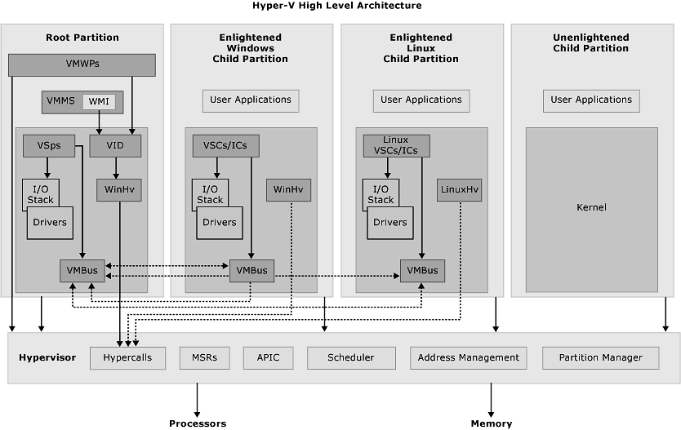
Hyper-V
source: Microsoft Technet, BizTalk 2009 Hyper-V Guide
Notes:
APIC – Advanced Programmable Interrupt Controller. A device which allows priority levels to be assigned to its interrupt outputs.
Hypercall – Interface for communication with the hypervisor.
IC – Integration component. Component that allows child partitions to communication with other partitions and the hypervisor.
MSR – Memory Service Routine.
Root Partition – Manages machine-level functions such as device drivers, power management, and device hot addition/removal. The root (or parent) partition is the only partition that has direct access to physical memory and devices.
VID – Virtualization Infrastructure Driver. Provides partition management services, virtual processor management services, and memory management services for partitions.
VMBus – Channel-based communication mechanism used for inter-partition communication and device enumeration on systems with multiple active virtualized partitions.
VMMS – Virtual Machine Management Service. Responsible for managing the state of all virtual machines in child partitions.
VMWP – Virtual Machine Worker Process. A user mode component of the virtualization stack. The worker process provides virtual machine management services from the Windows instance in the parent partition. The Virtual Machine Management Service spawns a separate worker process for each running virtual machine.
VSC – Virtualization Service Client. A synthetic device instance that resides in a child partition. VSCs utilize hardware resources that are provided by Virtualization Service Providers (VSPs) in the parent partition. They communicate with the corresponding VSPs in the parent partition over the VMBus.
VSP – Virtualization Service Provider. Resides in the root partition and provide synthetic device support to child partitions over the Virtual Machine Bus (VMBus).
WinHv – Windows Hypervisor Interface Library. WinHv is a bridge between a partitioned operating system’s drivers and the hypervisor, which allows drivers to call the hypervisor using standard Windows calling conventions
WMI – The Virtual Machine Management Service exposes a set of Windows Management Instrumentation (WMI)-based APIs for managing and controlling virtual machines.

Slide 12
Virtual devices
VMMS: Virtual Machine Management Service
VM Worker Process(es)
Virtual Motherboard
Virtual Devices (VDevs)
Core Virtual Devices
Emulated
Synthetic
Plug-in Virtual Devices
Synthetic
Notes:
Hierarchy of virtual devices in Hyper-V.

Slide 13
Planning Virtualization
Hyper-V implementation considerations & requirements

Slide 14
Analyzing
Microsoft Virtualization Solution Accelerators:
MAP Toolkit for Hyper-V
Infrastructure Planning and Design Guides
Hyper-V Security Guide
Private Cloud Fast Track

Slide 15
Sizing
Size each VM as you would a physical server running that workload.
Leave 1GB – 2GB RAM for the host OS.
For critical workloads, don’t over-commit CPUs.
Disk throughput may be largest bottleneck.
Consider storage teiring.
Consider SSDs w/ differencing disks.
If workload uses multiple disks in physical server, do the same when virtualizing.
Create a baseline and monitor performance.
Notes:
Performance Analysis of Logs tool:
http://pal.codeplex.com/

Slide 16
Considerations
Performance
Workload compatibility
Licensing
Business Continuity
Hardware needs
Security
Management and procedures

Slide 17
Requirements
x64 Processor with:
hardware assisted virtualization (Intel VT, AMD-V)
hardware Data Execution Prevention (Intel XD, AMD NX)
Second Level Address Translation (Intel EPT, AMD NPT or RVI)*
“sufficient” memory, networking, storage
no “special” hardware
* not required, but recommended
Notes:
systeminfo
SLAT
Intel Extended Page Tables
AMD Nested Page Tables or Rapid Virtualization Indexing

Slide 18
Licensing
Standard
Data Center
Hyper-V Server
Free download!
Usage scenarios:
already licensed Windows
VDI
solely other OSes
platform for Hosting providers

Slide 19
Consider conversion
P2V
tools
disk2VHD
backup → restore
cleanup
set devmgr_show_nonpresent_devices=1
remove unused devices from Device Manager
V2V
Microsoft Virtual Machine Converter

Slide 20
Why not to virtualize?
“special” hardware requirements
lack of support from software vendor (previously Oracle)
Active Directory Domain Controller (really?)
Notes:
What about when workload is similar in size to available host resources? What if you just create one VM? How about for high availability?

Slide 21
Configuring Hyper-V
How to configure and run a Hyper-V environment using the built-in tools.

Slide 22
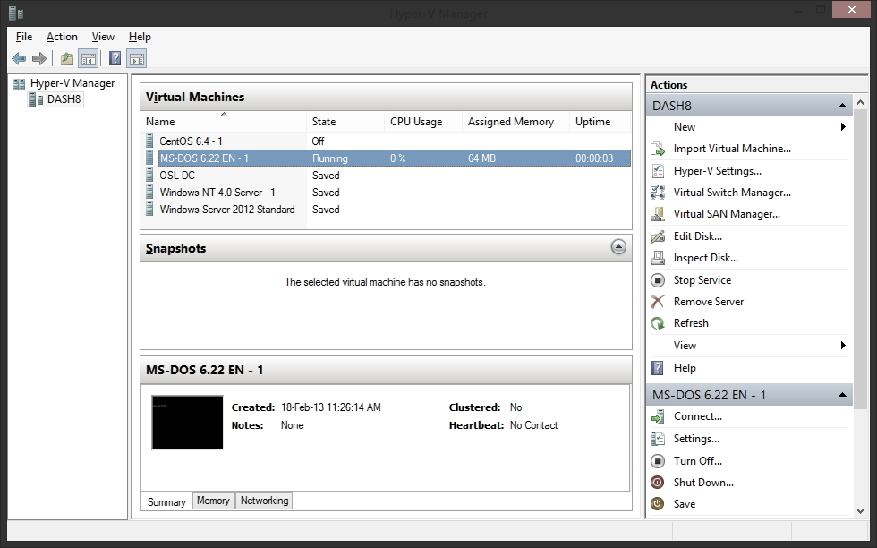
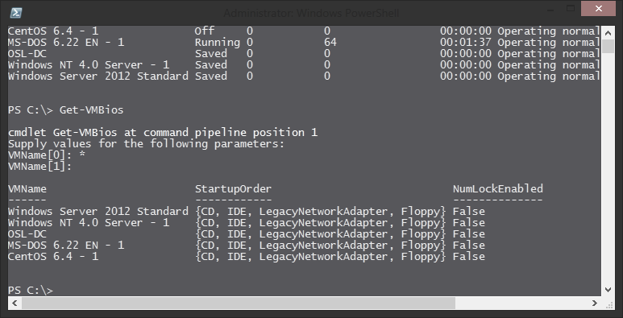
Management
Hyper-V Manager
RSAT
Failover Cluster Manager
RSAT
update from KB 2803748
PowerShell
System Center Virtual Machine Manager
Remote Desktop

Slide 23
Security
use Hypervisor Teiring
separate management responsibility
separate VMs by security context
for sensitive VMs, encrypt using BitLocker
consider Server Core; don’t run other applications on host OS
use VLANs
remember anti-virus and patch management
create anti-virus software exclusions for Hyper-V
implement IDS and IPS
Notes:
http://code.msdn.microsoft.com/Hyper-V-Remote-Management-26d127c6
See Hyper-V Security Guide: http://technet.microsoft.com/en-us/solutionaccelerators/cc197910
Anti-virus exclusions for Hyper-V Hosts:
http://social.technet.microsoft.com/wiki/contents/articles/2179.hyper-v-anti-virus-exclusions-for-hyper-v-hosts.aspx

Slide 24
Security for management
Hyper-V Administrators group
Remote access requires permissions, DCOM / WMI settings, and firewall rules
Windows Authorization Manager (AzMan) is deprecated.
Hyper-V Remote Management Configuration Utility (HVRemote) http://code.msdn.microsoft.com/Hyper-V-Remote-Management-26d127c6

Slide 25

review
next... Business Continuity with Hyper-V

